Slide 1

The Library
HSB Consulting Ltd Benjamin King | Henry Sly | Sharmaine Rufford
Notes:
Ben

Slide 2
Introduction
Tasked with creating a Library Management System for The Library
Time Period Allocated – 12 February 2020 to 19 June 2020
Creation of 3 Different Applications – Snatch & Go, EmailApplication & Rent a Leaf
Creation of MySQL Database consisting of 6 Tables
Notes:
Henry

Slide 3
Product Overview
Contacted by The Library to create a Library Book Management Systems allowing them to store details of books (including external information like Retailers) and Customers
Customers want to know what Books are available to issue, and want to be able to issue them
Librarians want to be able to add/alter/remove information stored about Books, Customers etc
Notes:
Sharmaine

Slide 4
Background
New library opening in Invercargill Central
HSB Consulting Ltd were approached by the developer Bob Smith to create a fully functional Library Management System which stores information about all the Books (and supporting information), and Customers of The Library.
Conceived the idea of 3 separate applications:
Rent a Leaf – the Main Application used by Librarians and Customers
Snatch and Go – Self Checkout Application
AutomaticEmails – Automatic Reminder Emails Application
Notes:
Ben

Slide 5
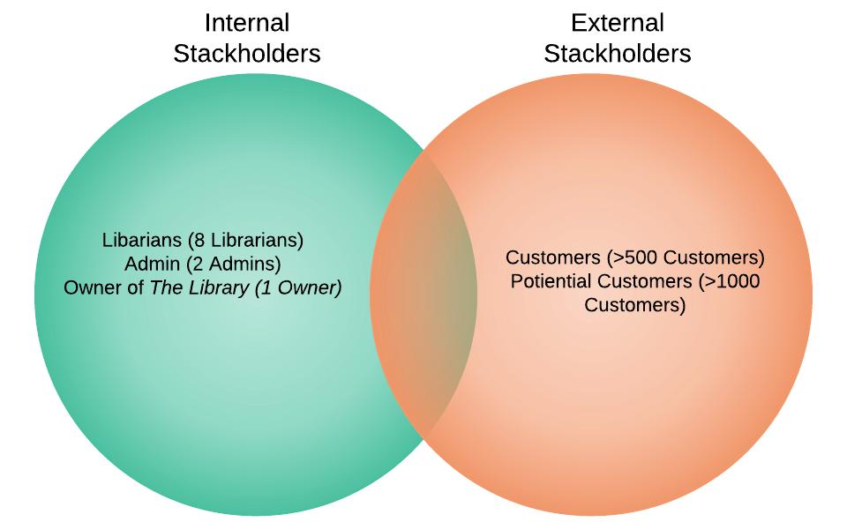
Audience/Stakeholders
Notes:
Ben

Slide 6
Approach
Prior Knowledge of SQL
Prior Knowledge of C# Programming and Design
Notes:
Henry

Slide 7
Architecture of System
Rent a Leaf – Librarian/ Customer Application
Snatch and Go – Self-checkout application
MySQL Database
AutomaticEmails – Console Based Email Application
Notes:
Ben

Slide 8

The Process
Analysis (18/2/20 – 31/3/20)
Identify the needs of the System
The Requirements and Scope of the System
Analysis & Design (1/4/20 - 8/5/20)
Design of the Database Schema (Tables, Queries etc)
Conceptualisation of 3 different Applications
Development (14/4/20 – 10/06/20)
Creation of SQL Database
Creation of C# Forms (and Console) Based Applications
Testing & Deployment (1/6/20 – 17/6/20)
Testing of SQL Injection
Testing of Loading Forms
Testing of Reminder Emails, Texts etc
Testing of Client & Service Validation
Notes:
Sharmaine

Slide 9
Result
Three Fully Functional Applications
Users can login and perform a variety of Tasks
Implemented Reminder Emails and SMS Messages
Demo of working System will be shown after this presentation
Notes:
Sharmaine

Slide 10
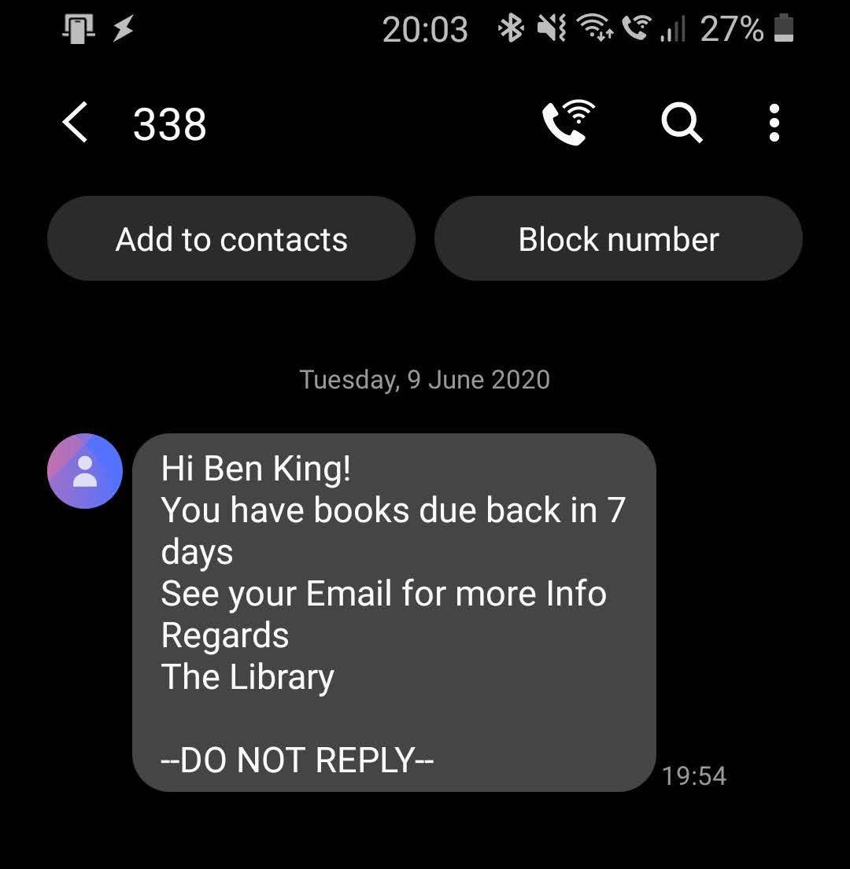
Reminder Emails/SMS Messages
Application looks up in the database to find books due back in 7 days. For each Customer it sends 1 email with a list of books that are due back. An SMS Message is sent to inform them at the same time
Application looks up in the database to find books that are now overdue (due the previous day), sending them 1 email with a list of books which are now overdue. An SMS Message is sent to inform them at the same time
Application looks up in the database to find books which are overdue for 14 days, setting that user to blocked and sending them an email informing them that they have been blocked. An SMS Message is sent to inform them at the same time
All Configuration Files saved in a Settings File allowing them to be changed and customised in the future
Notes:
Ben

Slide 11
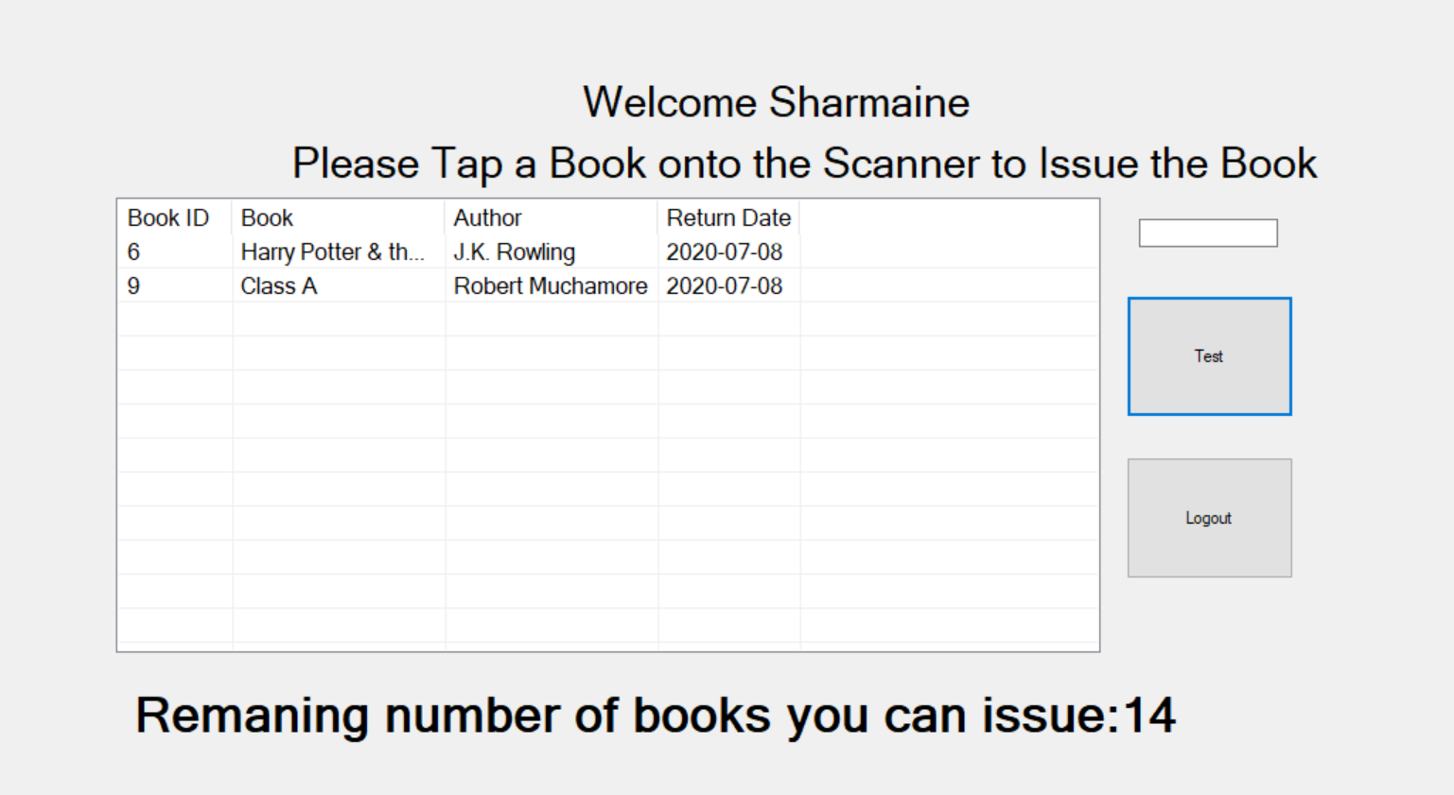
Snatch and Go - Issuing
Read Customers Identity through RFID Reader, and find their entry in the Customers Table in MySQL Database.
Check the security level on the user, restricting their abilities.
Read BookCopies Identity through RFID Reader,
Check the security level of the book, either issuing the book or not depending on the result.
Add entry into the BooksOnHold Table, issuing the book and showing a message
Allowing the user to issue up to their allowing issue limit
Sending Receipt if requested on users logout
Notes:
Ben

Slide 12
Snatch and Go - Returning
Switch to Returning Mode by clicking Button on Screen
Identifying the book on the RFID Reader and finding its entry in the BooksIssued Table
Returning the book by setting a Returned_Date value as the current Date
Checking whether there are any holds on the book.
Allowing the Librarian to return a new book after the previous book has been returned
Notes:
Ben

Slide 13
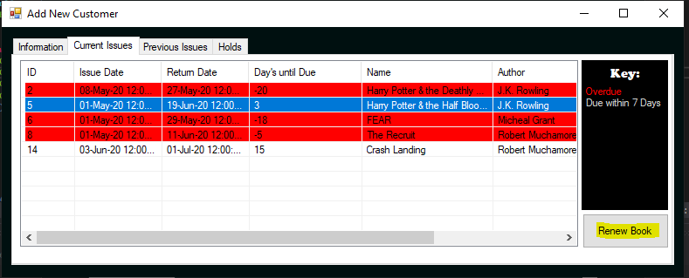
Rent a Leaf – View Current Issues
Customer launches the application, connecting to the MySQL Database
Customer Logins to the application with their username (email address) and password
Customer Selects to view their Details, and then selects the Current Issues Tab
Notes:
Henry

Slide 14
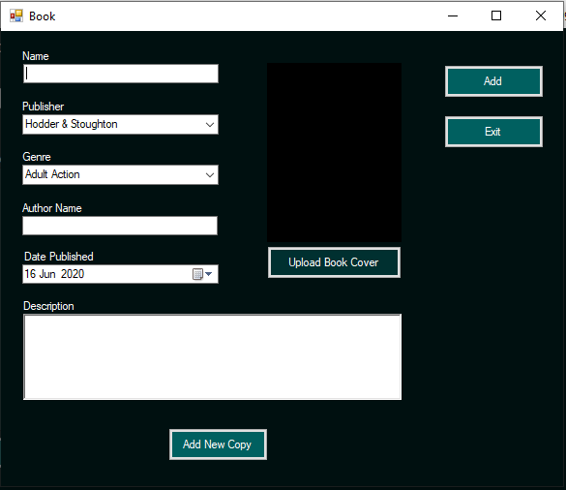
Rent a Leaf – Add new Book
Librarian launches the application, connecting to the MySQL Database
Librarian Logins to the application with their username (email address) and password
Librarian select the Option to Add New Book
Librarian fills out the Book Details into the Text Boxes
Librarian Clicks to Add New Book to Database
If not all the fields are filled in the Librarian is prompted to fill them in in order to add it to the Database
If the data is valid, the Book is added to the Books Table
Notes:
Henry

Slide 15
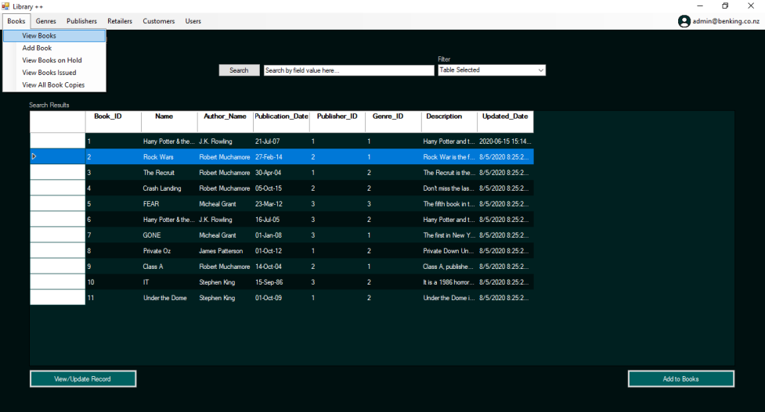
Rent a Leaf – Search for Existing Book
User launches the application, connecting to the MySQL Database
User Logins to the application with their username (email address) and password
User selects Book as the object selector to be searched
User enters in and selects the search parameters
User clicks search
If any books match the query they are shown and user can double click for more details
If no books match the query, no books are shown
Notes:
Henry

Slide 16
Future Enhancements
Notes:
Ben

Slide 17
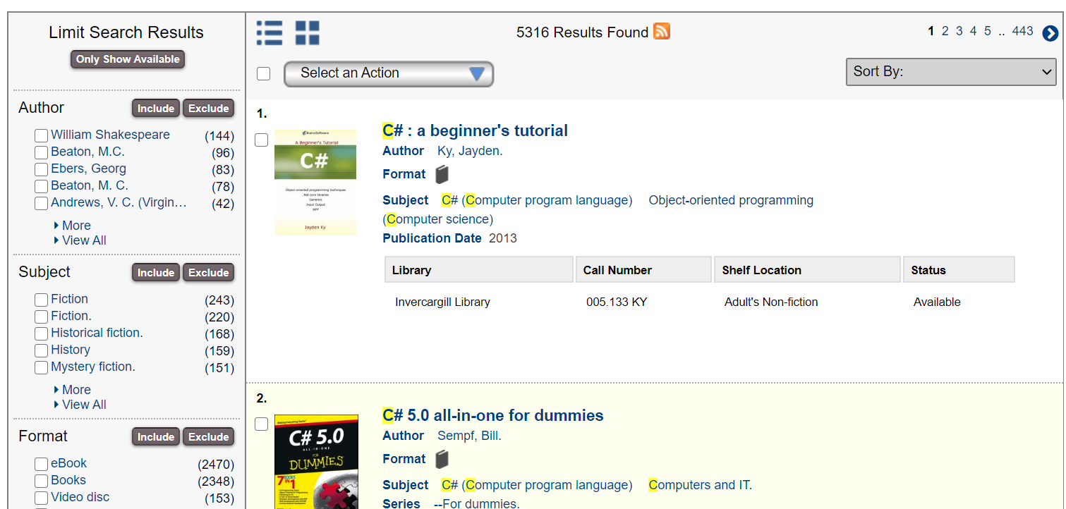
Website Solution
Improve and Modernise the Solution
Enhanced Filters
Improved Accessibility

Slide 18

Security
2 Factor Authentication for Login/Performing Functions and features
Provided via SMS or Real Time Based Authenticator Apps
Biometric Logins
DNA/Blood Test
Fingerprint
Facial Recognition

Slide 19
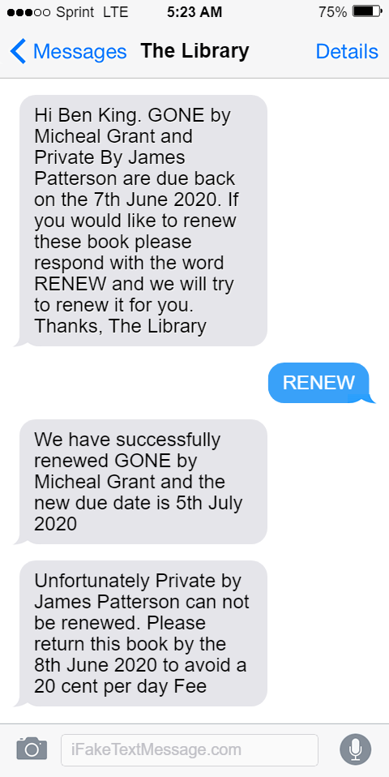
Enhanced Reminder Texts
Ability to Respond to Text Messages
Ability to Get Responses Back (to and from the Library)
Perform Functions automatically like Renewing Books

Slide 20
Mobile Applications
Customer based – similar features to Rent a Leaf
Libarain Based – Similar features to Rent a Leaf

Slide 21
Schedule
Gantt Chart
Notes:
Sharmaine

Slide 22
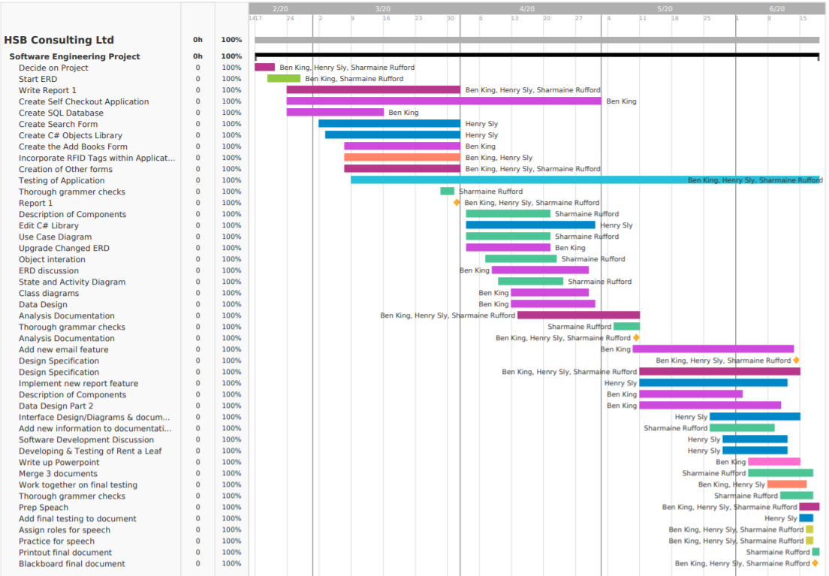

Slide 23

Summary
HSB Consulting Ltd created a Library System consisting of a SQL Database and 3 Applications that work to operate a fully functional system
SQL Database
Rent a Leaf Application
Snatch and Go Application
AutomaticEmails Application
Notes:
Henry

Slide 24
Demonstration

